Slide 1
ACC TRACKMAN DATA / OFFENSIVE MODELING
What Drives Offensive
Success in Baseball?
Using ACC TrackMan Data to Model Expected Offensive Production
Andrew Lucas · CMU Data Science Capstone
CONTACT QUALITY → EXPECTED PRODUCTION

Slide 2
RESEARCH QUESTION
02
Which underlying skills best explain season-long offensive success?
253,062 pitches · ACC 2026 regular season · TrackMan data
ANALYTICAL FRAME
Can process explain
what OPS alone cannot?
01
CONTACT QUALITY
EV · launch angle · direction
Separate contact quality from plate discipline, then combine both into expected OPS.
02
PLATE DISCIPLINE
count · location · pitch type
03
EXPECTED OPS
player-level offensive profile

Slide 3
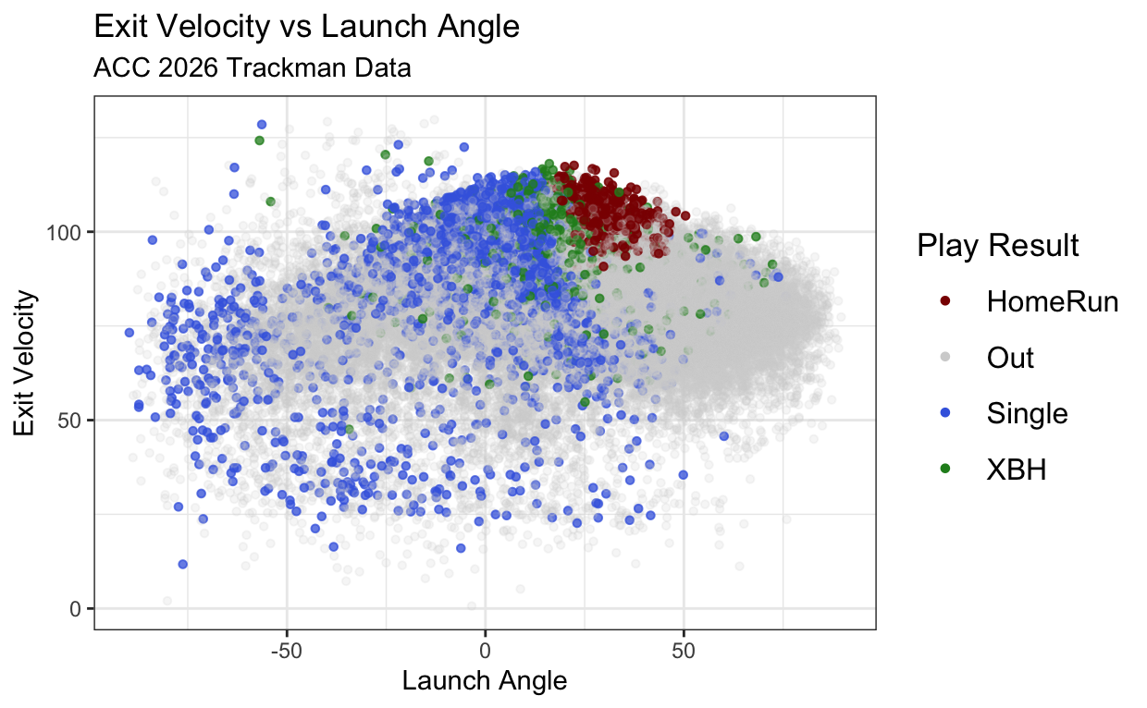
SUCCESSFUL CONTACT
03
Hard contact at favorable launch angles produces the best outcomes.
Exit velocity vs SLG: r = .456 · Launch angle vs SLG: r = .370

Slide 4
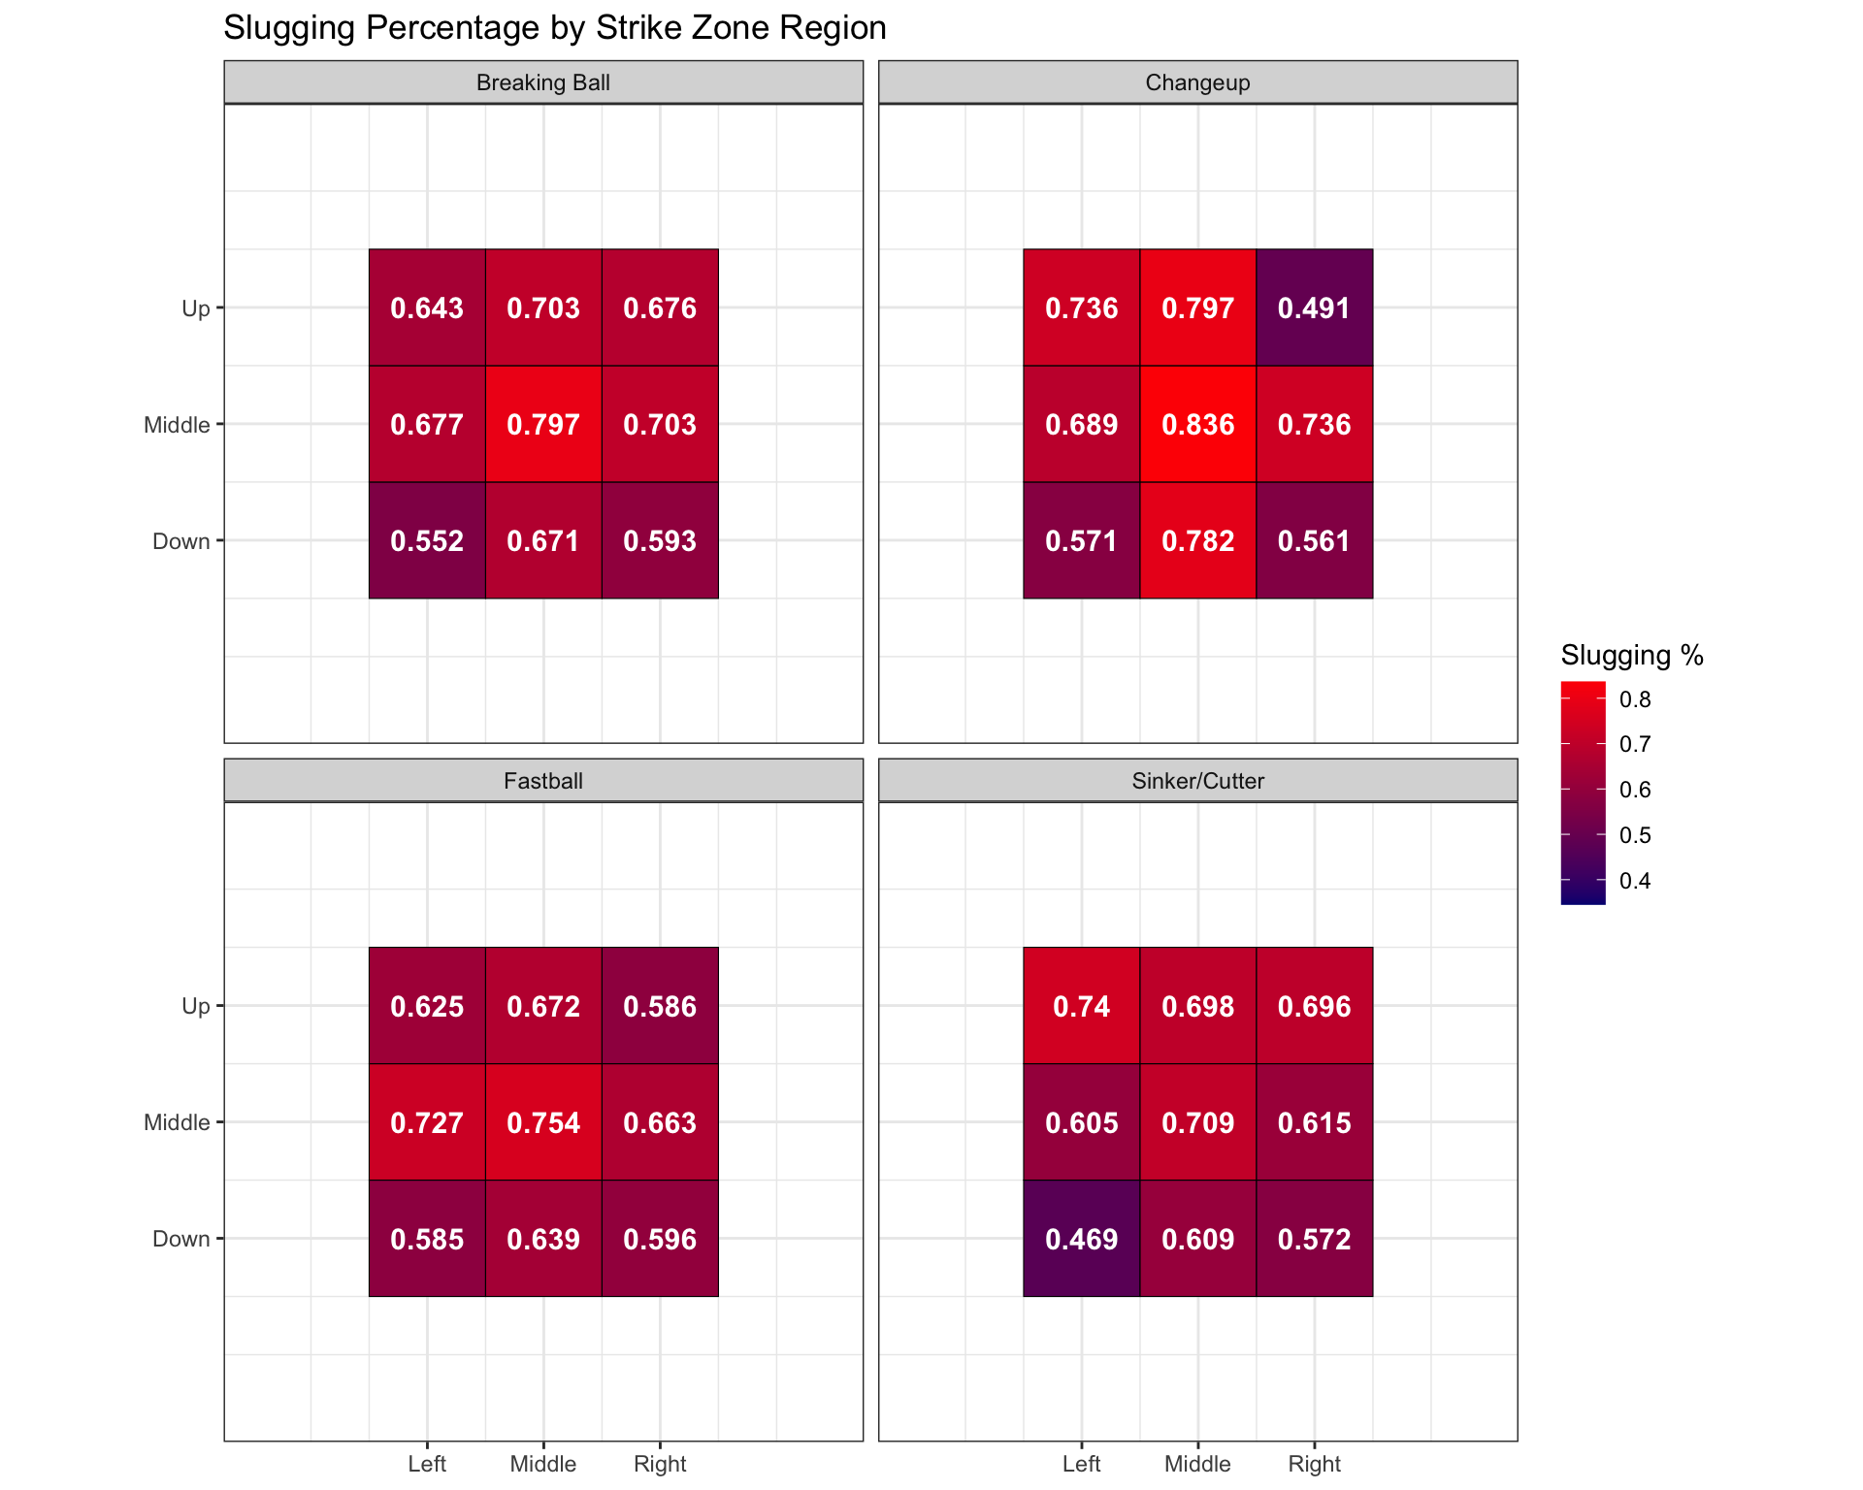
PITCH LOCATION
04
Heart-of-zone pitches generated the most damage.
Middle-middle SLG: .836 vs changeups · .797 vs breaking balls
Pitches executed down and toward either lower corner were associated with lower offensive production.
Locations use a fixed catcher-view orientation; handedness-specific splits are a future refinement.

Slide 5
BUILDING XOPS
05
Predict pitch outcomes first; interpret underlying skill at the player level.
Two Random Forest models · 20% holdout test set
INPUTS
XBA + XSLG
XBB + XK + XHBP
EXPECTED OUTCOME
TRACKMAN DATA
CONTACT MODEL
DISCIPLINE MODEL
xOPS
CONTACT ACCURACY
DISCIPLINE ACCURACY
76.8%
82.4%

Slide 6
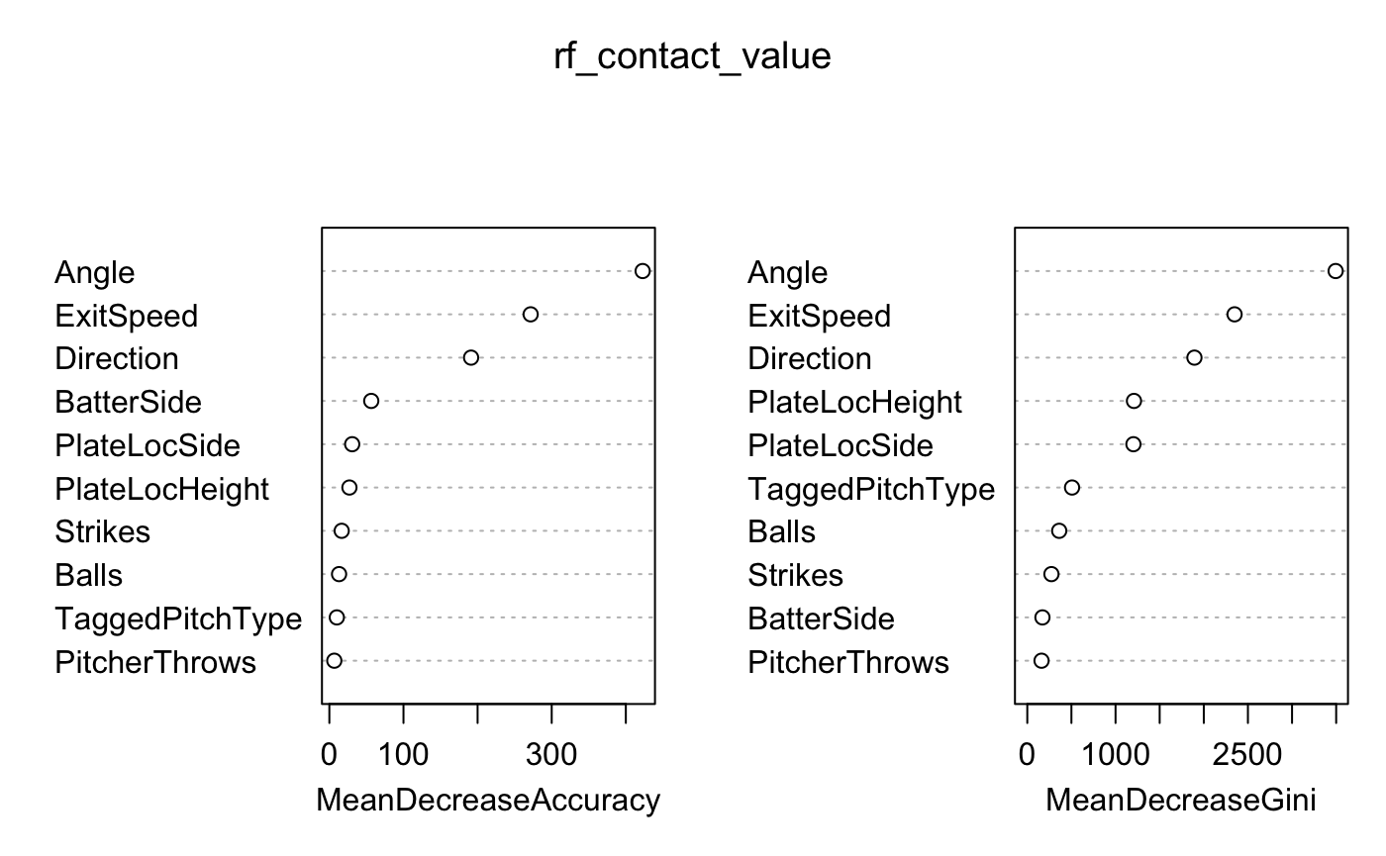
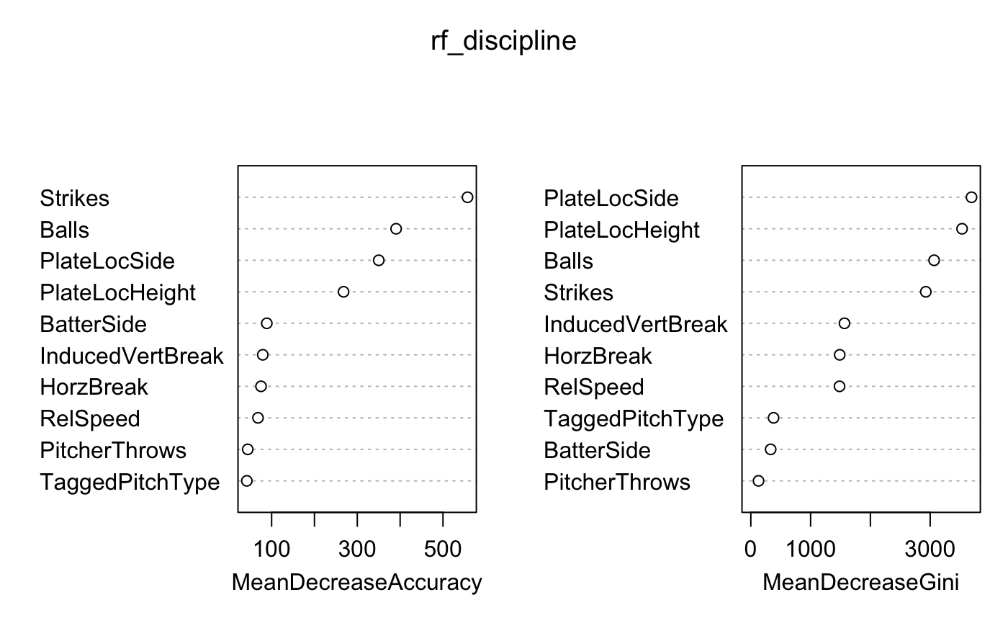
TWO MODELS, TWO QUESTIONS
06
What drives contact value? What drives plate-discipline outcomes?
Random Forest variable importance · accuracy and Gini views
MODEL 1 · CONTACT VALUE
MODEL 2 · PLATE DISCIPLINE
Angle · exit speed · direction
Count · pitch location

Slide 7
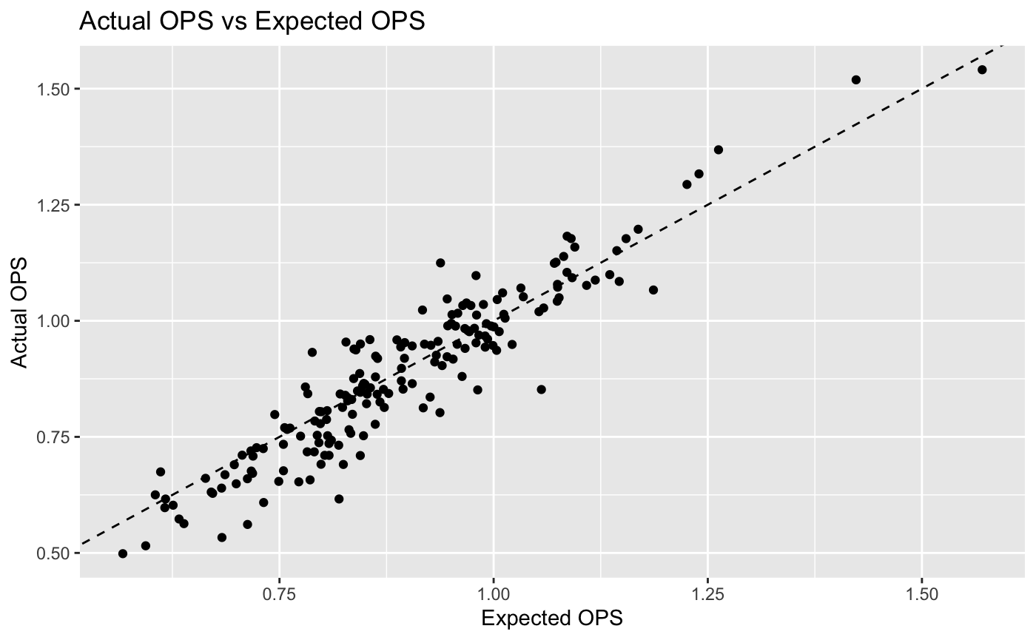
DOES XOPS WORK?
07
Expected OPS closely tracks observed performance.
r = .931 · p < .001

Slide 8
PLAYER APPLICATIONS
08
OPS minus xOPS highlights candidates for improvement or regression.
Largest player-level gaps · minimum sample varies
UNDERPERFORMERS
OVERPERFORMERS
BATTER
PA
OPS
xOPS
GAP
BATTER
PA
OPS
xOPS
GAP
Jimmy Keenan
119
.852
1.056
−.204
Willie Hurt
58
1.125
.938
+.187
Danny Surowiec
118
.616
.820
−.203
Brock Sell
85
.932
.788
+.144
Ty Dalley
116
.561
.713
−.151
Cort MacDonald
142
.954
.828
+.127
Ben Williams
64
.533
.683
−.150
Jarren Advincula
231
1.097
.979
+.118
Zach Jackson
170
.802
.937
−.135
Jacob French
121
1.023
.917
+.106

Slide 9
CONCLUSIONS & LIMITATIONS
09
xOPS reveals underlying skill and helps identify potential diamonds in the rough.
CONCLUSIONS
LIMITATIONS
CONTACT
Launch angle, exit velocity, and spray direction drive contact value.
COVERAGE
Not every ACC venue or game had TrackMan data.
DISCIPLINE
Count and pitch location shape plate-discipline outcomes.
MISSING DATA
Incomplete pitch tags were excluded from portions of the analysis.
GAME STATE
Baserunner context was unavailable, limiting sacrifice-fly modeling.
xOPS
The OPS–xOPS gap flags players whose results may not match their process.
DEFENSE
No fielder-positioning data were available to estimate hit probability.
NEXT STEP
Add ballpark effects, opponent quality, defensive positioning, and year-to-year validation.

